Slide 1
DATABASE PROJECT
BY:
SEAN MILACHOUSKI
AHMED NEHAL

Slide 2
Problems Handling
Query Questions
SQL Codes
Results

Slide 3
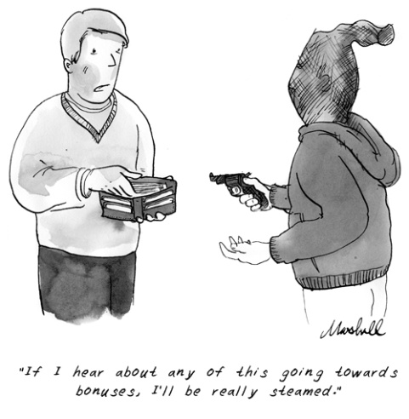

First Query:
Find the name and number of all experts whose normal appraisal fee is sometimes larger than any fee that the expert has ever charged for an appraisal.
+

Slide 4
First Query - SQL
CREATE VIEW EX
AS SELECT E.ENO, E.ENAME
FROM E, A
WHERE E.ENO = A.ENO
AND A.FEE > E.CHARGE;
SELECT ENO "Expert No.",ENAME "Expert Name"
FROM EX;

Slide 5

First Query - Result
Exp Expert Name
--- ----------------------
E01 Gumby Green
E03 Frankenstein
E01 Gumby Green
E04 Bob Mechs

Slide 6

Second Query:
Find the name and number of all inventions that have a similar invention.

Slide 7
Second Query - SQL
SELECT I.INO "Invention No.", I.NAME "Invention Name"
FROM I
WHERE INO IN
(SELECT INOA
FROM S
WHERE S.INOA = I.INO)
OR INO IN
(SELECT INOB
FROM S
WHERE S.INOB = I.INO)
ORDER BY INO ASC;

Slide 8
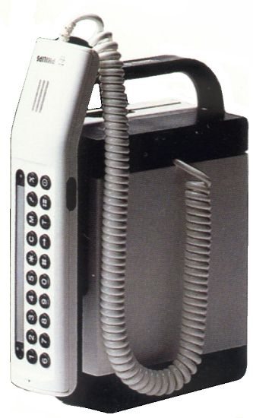
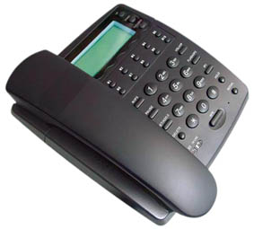
Second Query - Results
Inv Invention Name
--- -----------------------
I01 Cell Phone
I02 LAN Phone

Slide 9
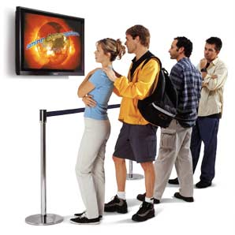
Third Query:
For each invention that has been bought, find how many different customers (not inventors) have bought the invention.

Slide 10
Third Query - SQL
SELECT INO "Invention Number", COUNT(CNO) "Number of Customers Bought"
FROM B
GROUP BY INO;

Slide 11

Third Query - Result
Input truncated to 13 characters
Inv Number of Customers Bought
--- --------------------------
I01 3
I02 2
I03 3
I04 2
I05 2
I06 3
I07 2
I08 3
8 rows selected.

Slide 12

Fourth Query:
Find the country where the most inventions were invented.

Slide 13
Fourth Query - SQL
CREATE VIEW Inv_No
AS SELECT COUNTRY, COUNT(*) AS No_Inv
FROM I
GROUP BY COUNTRY ;
CREATE VIEW Most_Inv
AS SELECT MAX(No_Inv) AS Mst_Inv
FROM Inv_No;
SELECT COUNTRY, Mst_Inv "No. of Inventions"
FROM Inv_No, Most_Inv
WHERE Inv_No.No_Inv = Most_Inv.Mst_Inv;

Slide 14

Fourth Query - Result
View created.
View created.
COUNTRY No. of Inventions
---------------------------------------- -----------------
Russia 3

Slide 15

Fifth Query:
Create a view that has for each country, the average rating of the experts from each country. Which country has the largest average rating of experts.

Slide 16
Fifth Query - SQL
CREATE VIEW RATINGperCOUNTRY
AS SELECT COUNTRY, AVG(RATING) AS COUNTRYRATE
FROM E
GROUP BY COUNTRY;
CREATE VIEW BEST_EX
AS SELECT MIN(COUNTRYRATE) AS EX_RATING
FROM RATINGperCOUNTRY;
SELECT COUNTRY, EX_RATING "BEST Rating"
FROM RATINGperCOUNTRY, BEST_EX
WHERE RATINGperCOUNTRY.COUNTRYRATE = BEST_EX.EX_RATING;

Slide 17

Fifth Query - Result
View created.
View created.
Input truncated to 55 characters
COUNTRY BEST Rating
---------------------------------------- -----------
Paraguay 1
USA 1
SQL> select *
2 FROM RATINGperCOUNTRY;
COUNTRY COUNTRYRATE
---------------------------------------- -----------
Paraguay 1
Romania 3
Russia 4
USA 1

Slide 18
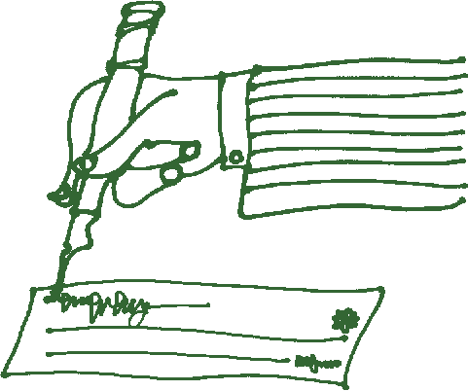
Sixth Query:
For each customer, find the total amount of money the customer is willing to spend.

Slide 19
Sixth Query - SQL
CREATE VIEW H_P
As SELECT INO, MAX(PRICE) AS High_Prc
FROM R
GROUP BY INO;
CREATE VIEW H_C
As SELECT CNO, PRICE
FROM R;
CREATE VIEW H_P_C
As SELECT CNO, High_Prc
FROM H_P, H_C
WHERE H_P.High_Prc=H_C.PRICE;
SELECT CNO "CUSTOMER No.", SUM(High_Prc) "Price Willing to Spend"
FROM H_P_C
GROUP BY CNO;

Slide 20
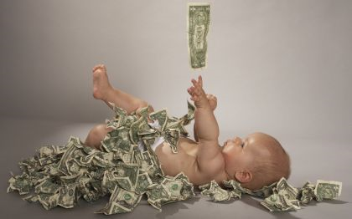
Sixth Query - Result
View created.
View created.
View created.
Input truncated to 13 characters
CUS Price Willing to Spend
--------------------------
C01 21106
C02 13333
C05 16662

Slide 21
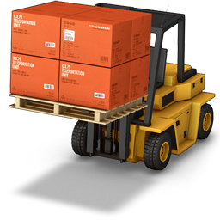
Seventh Query:
Find the name and number of customers who have bought every invention at least once.

Slide 22
Seventh Query - SQL
SELECT CNO "Customer No.", CNAME "Customer Name"
FROM C
WHERE NOT EXISTS
(SELECT *
FROM I
WHERE NOT EXISTS
(SELECT *
FROM B
WHERE B.INO = I.INO
AND B.CNO = C.CNO));

Slide 23

Seventh Query - Result
Input truncated to 21 characters
Cus Customer Name
-----------------------------------------------------------
C01 John Tucker
C05 Willis Bord

Slide 24


Eighth Query:
Find all experts who come from a country that has neither letter “e” nor “t” but has the letter “r” although it cannot be the 2nd letter in the name. We also do not know the country that the expert is from although we do know that the expert’s rating is better than the lowest possible.

Slide 25
Eighth Query - SQL
SELECT ENO "Expert No.", ENAME "Expert Name", COUNTRY
FROM E
WHERE RATING < 5
AND
( COUNTRY LIKE 'R%'
OR COUNTRY LIKE '%r%'
AND COUNTRY NOT LIKE '_r%‘)
AND
( COUNTRY NOT LIKE 'E%'
AND COUNTRY NOT LIKE '%e%‘
AND COUNTRY NOT LIKE 'T%'
AND COUNTRY NOT LIKE '%t%');

Slide 26



Eighth Query - Result
Exp Expert Name
--- --------------------------------------------------
COUNTRY
----------------------------------------
E01 Gumby Green
Russia
E02 Samuri Jack
Paraguay
E03 Frankenstein
Romania

Slide 27
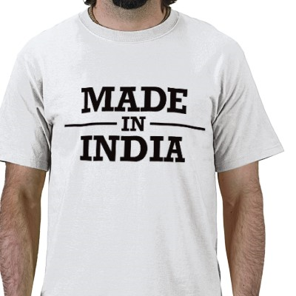
Ninth Query:
Find the name and number of all customers who own at least one invention from India but no inventions from Mexico and Spain.

Slide 28
Ninth Query - SQL
SELECT C.CNO "Customer No.", C.CNAME "Customer Name"
FROM C, O, I
WHERE C.CNO = O.CNO
AND I.INO = O.INO
AND
(I.COUNTRY = 'India'
AND I.COUNTRY <> 'Spain'
AND I.COUNTRY <> 'Mexico');

Slide 29

Ninth Query - Result
Cus Customer Name
--- ------------------------------------------------------------
C05 Willis Bord
SQL> exit

Slide 30

QUESTIONS:

Slide 31
THE END
Thank You

